Slide 1
Java oktatás
JMS

Slide 2
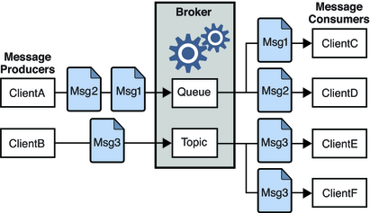
JMS
javax.jms
ConnectionFactory
Message
Queue
Point-to-Point
Topic
Publish/Subscribe

Slide 3
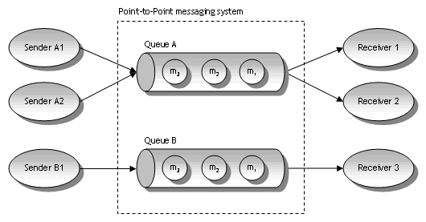
Queue

Slide 4
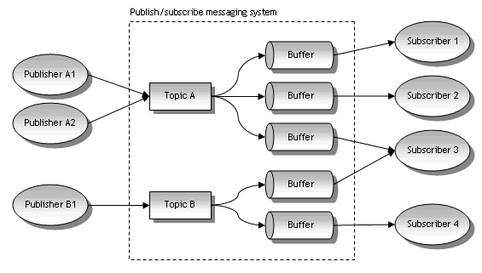
TOPIC

Slide 5
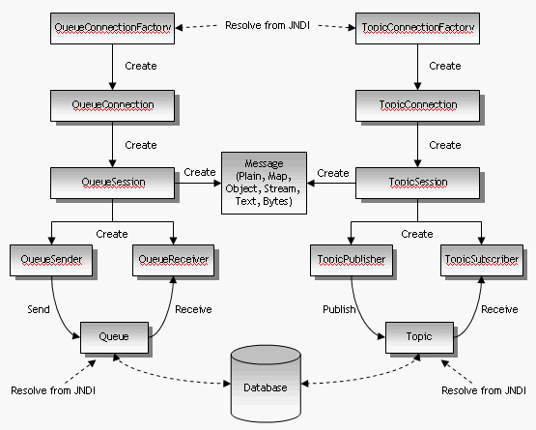
JMS működése

Slide 6
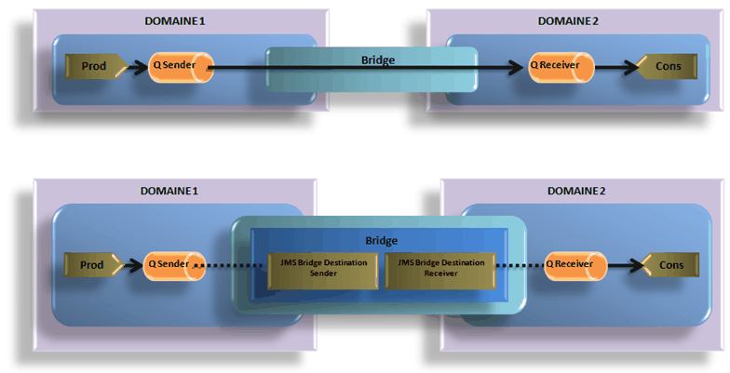
Bridge

Slide 7
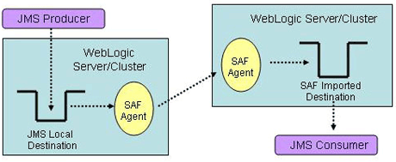
Store-and-Forward Agents

